Slide 1
ASTHMA Disease Prediction
Preethi Mathari
SOWMYA ILA
SRILEKHA

Slide 2
Asthma is a chronic respiratory condition characterized by inflammation of the airways, resulting in symptoms such as wheezing, shortness of breath, coughing, and chest tightness.
We utilize a dataset containing various patient characteristics and asthma severity levels.
• Our analysis involves exploring features, visualizing data distributions, and training multiple classifiers including Random Forest, Gradient Boosting, and K-Nearest Neighbors.
• By evaluating model performance metrics like accuracy and confusion matrices, we aim to improve asthma prediction for proactive healthcare interventions.
• Early prediction can aid in better management and treatment, reducing the severity of attacks.
INTRODUCTION

Slide 3
DATASET OVERVIEW
The dataset used for this project was sourced from Kaggle
The main features used in this analysis include:
Tiredness
Dry-Cough
Difficulty-in-Breathing
Sore-Throat
None_Symptom
Pains
Nasal-Congestion
Runny-Nose
None_Experiencing
Age groups (Age_0-9, Age_10-19, Age_20-24, Age_25-59, Age_60+)
Gender (Gender_Female, Gender_Male)
Target Variable: The target variable in this analysis is 'Severity_Mild'. This variable indicates the severity level of asthma episodes and is crucial for predicting and managing asthma exacerbations.

Slide 4
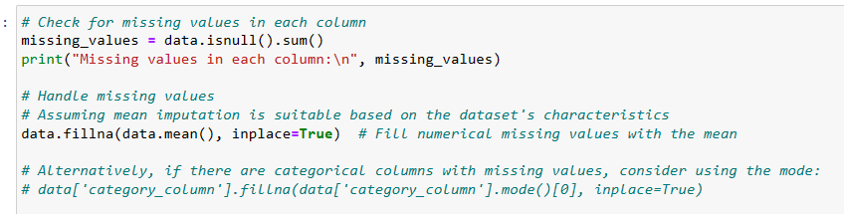
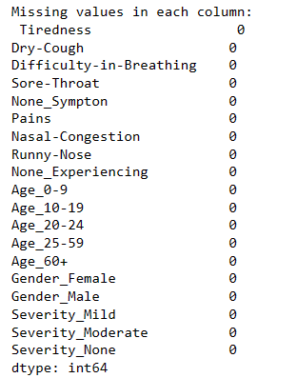
DATA PREPROCESSING
The first part of code checks if there are any missing values (blank or empty cells) in the dataset.
The second part of the code deals with filling the missing values in the dataset with the mean (average) value of the respective column.
The next part of the code converts the categorical variables like colors or types into numerical format because most machine learning algorithms can only work with numerical data.

Slide 5
EXPLORATORY DATA ANALYSIS (EDA):
• Visualized asthma severity distribution using a bar chart to understand how often different severity levels, such as 'Mild,’ has occured.
•Used a heatmap to show correlations between variables like age, gender, and asthma severity, helping spot relationships between the factors.

Slide 6
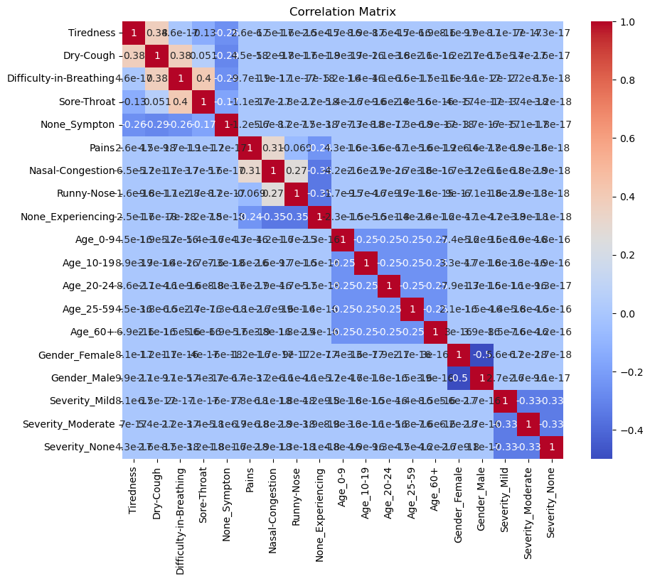
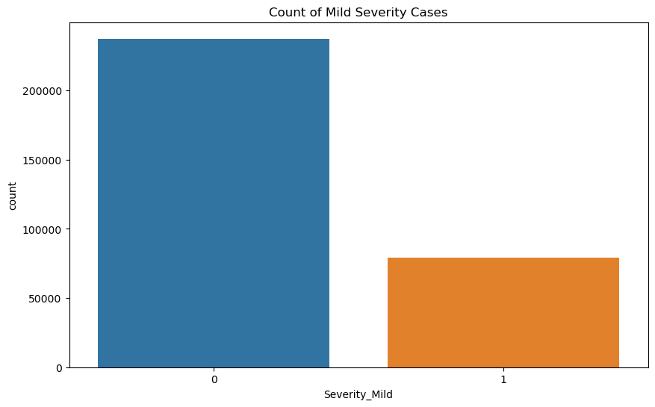

Slide 7
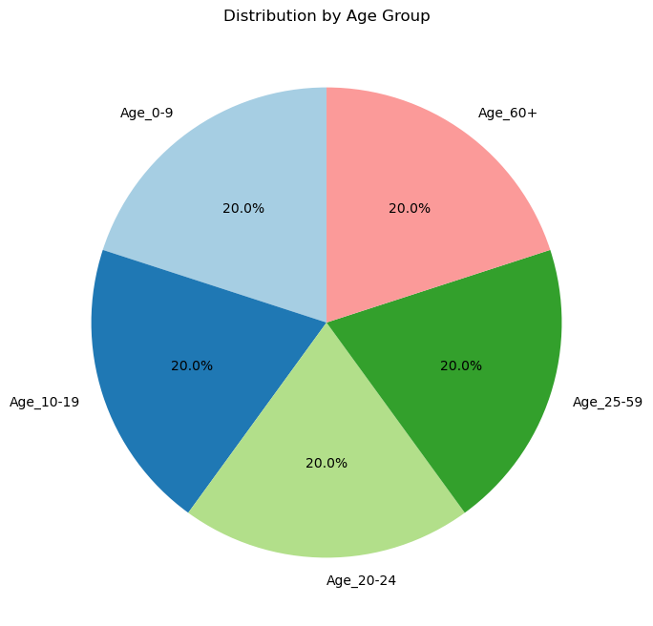
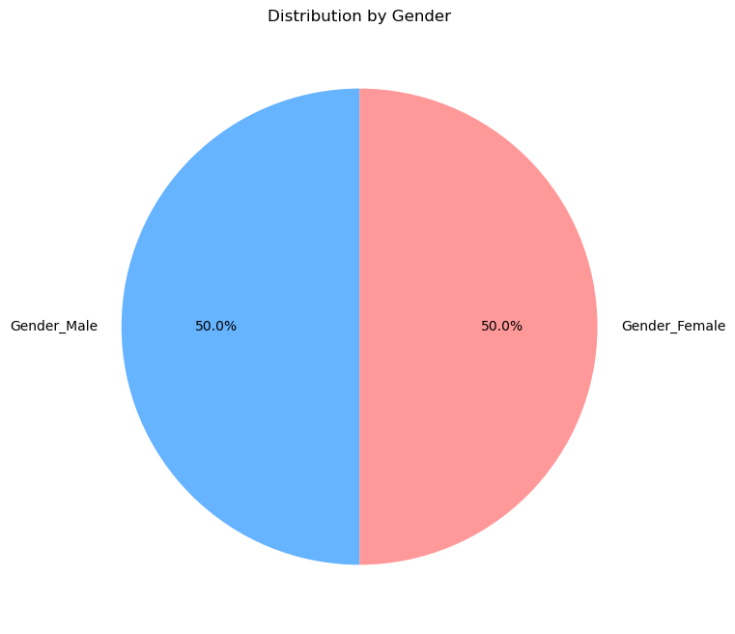
Age group distribution is displayed with a pie chart, giving insight into the dataset using potential age-related patterns in asthma severity.
Present gender distribution among asthma patients via a pie chart, offering a clear view of the proportion of male and female individuals in the dataset.

Slide 8

MODEL ANALYSIS
Data Splitting:
The dataset is split into features (X) and the target variable (Y). It's assumed that the features are stored in a DataFrame named df, and the target variable is named ‘severity mild'. The data is split into training and testing sets using the train_test_split function.
GRADIENT BOOSTING CLASSIFIER:
Utilized a Gradient Boosting Classifier with 100 decision trees, trained on provided data to predict outcomes.
The model made predictions on test data, achieving an accuracy of 75.08%, signifying its capability to correctly classify instances.
The confusion matrix displayed that out of the total test cases, 31,666 were true negatives, reflecting the model's strong ability to correctly identify negative instances. Meanwhile, it also recorded 15,975 true positives, indicating that it correctly identified all positive cases in the dataset. However, there were 15,719 false positives, which implies a considerable number of instances were incorrectly classified as positive. Utilized Confusion MatrixDisplay to visually present the confusion matrix, providing insights into the model's classification performance, particularly its strengths and areas for improvement.

Slide 9
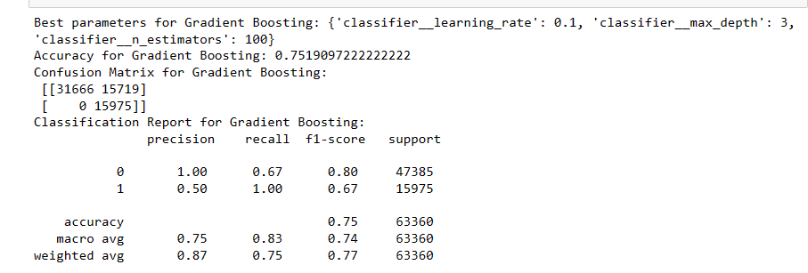
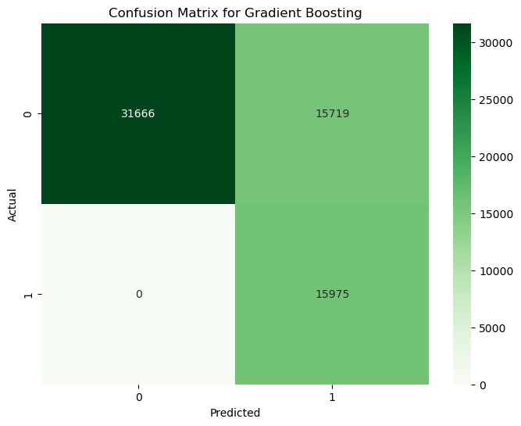

Slide 10
Random Forest Classifier
The Random Forest model is initialized and trained using the X_train dataset, which contains the features, and y_train,
After training, the model uses the X_test dataset to predict outcomes.
Evaluation: The accuracy of these predictions is assessed using the accuracy_score() function. Additionally, the model's detailed performance is analyzed through a confusion matrix and a classification report, which provide metrics like precision, recall, and F1-score.

Slide 11
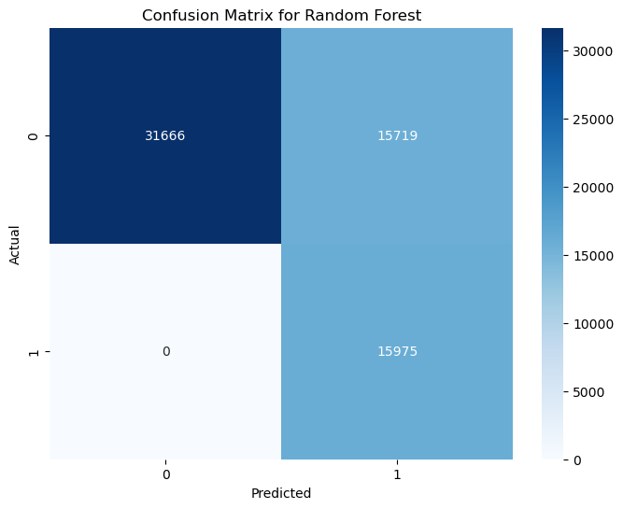
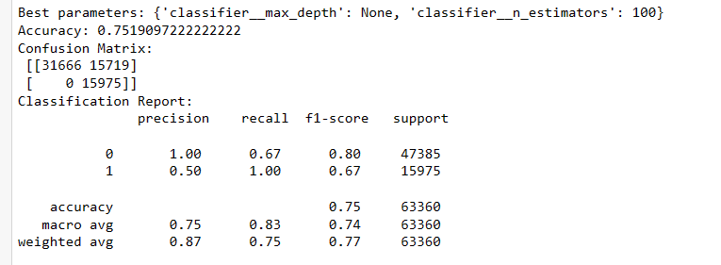

Slide 12

Model Validation
We used pipelines integrated with SMOTE (Synthetic Minority Over-sampling Technique) to balance the dataset, which is important for handling class imbalance.
We employed multiple classifiers (Random Forest, Gradient Boosting, and K-Nearest Neighbors) and tuned them using GridSearchCV to find the best parameters. This approach helps in selecting the most effective model and parameters.
For each model, you have provided a detailed evaluation using accuracy, confusion matrices, and classification reports, allowing for a thorough assessment of each model's performance.

Slide 13

KNN Classifier
A K-Nearest Neighbors (KNN) classifier with 5 neighbors was trained using the training data (X_train and y_train) to learn patterns for prediction.
The model predicted outcomes on test data (X_test), achieving an overall accuracy of 74.53%, indicating a fair level of prediction correctness.
The confusion matrix revealed 39,431 true negatives and 7,954 true positives, with a precision and recall of 83% and 49% for negative and positive classes respectively, showing better performance in identifying negative instances.

Slide 14
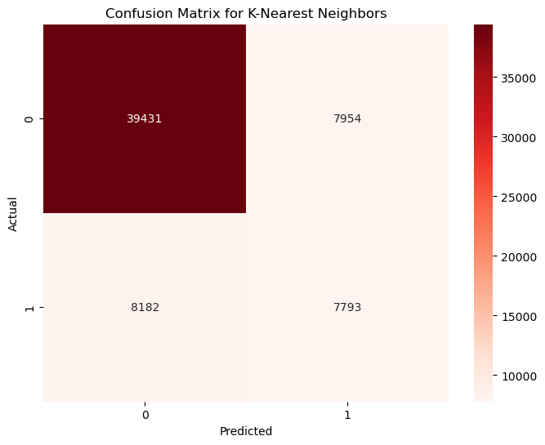
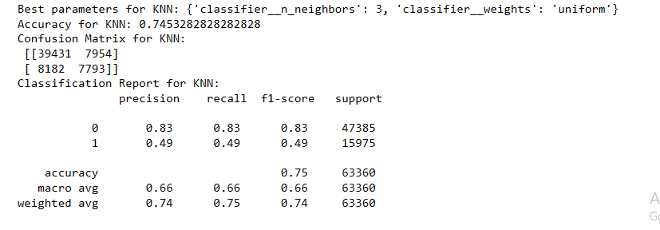

Slide 15

CONCLUSION
Random Forest and Gradient Boosting showed 100% recall, meaning they detected all actual cases of asthma but also had many false positives.
K-Nearest Neighbors had slightly lower overall accuracy but provided a more balanced performance in terms of precision and recall.
High sensitivity is valuable in medical settings to ensure no asthma case is missed, but the high false positive rate could lead to unnecessary treatments or anxiety, suggesting a need for model refinement.

Slide 16

CHALLENGES
Identifying and engineering the most predictive features, especially from medical datasets, can be challenging. The current model may benefit from more detailed symptom data or environmental factors that could influence asthma conditions.
Handling class imbalance effectively remains a challenge. Techniques like SMOTE are used, but they can introduce their own issues like overfitting or bias towards minority classes. Testing alternative methods or adjusting class weights within the model could provide improvements.
The asthma prediction model must work well not just with the data it was trained on, but also with new data it hasn't seen before, especially from different types of people and places. This means checking to make sure the model is reliable for everyone, no matter where they're from or their background

Slide 17

FUTURE GOALS
By including a wider range of information like a patient's previous health history, where they live, and their genetic background, the model can make better and more accurate predictions about whether someone might have asthma.
Using newer and more complex methods in machine learning, like neural networks (which are models inspired by human brain function) or combining several different models to work together, could help make the predictions more precise.
Further tuning of model parameters and exploring more sophisticated machine learning algorithms could enhance performance.

Slide 18
THANK YOU
Dataset link:
https://www.kaggle.com/code/hsingc/asthma-disease

